Slide 1
Managing Requirements
doug murray consulting
Getting the Right Requirements Right
doug murray
february 9, 2017
system architect

Slide 2
Agenda
Why Requirements?
Writing Requirements
Requirements of Good Requirements
Where Do We Find Them?
Organizing Them
doug murray
february 9, 2017
doug murray consulting
system architect

Slide 3
Agenda
Why Requirements?
Writing Requirements
Requirements of Good Requirements
Where Do We Find Them?
Organizing Them
doug murray
february 9, 2017
doug murray consulting
system architect

Slide 4
Why Do We Need Requirements?
Gathering and understanding requirements make projects more predictable
Bad requirements historically account for most of the rework done later in the project
Reducing the number of defects caused by poor requirements can yield a 7 to 1 return on investment
doug murray
february 9, 2017
system architect
february 9, 2017
doug murray consulting
Notes:
Sounds good, but to better understand this we should start at the top, with the basics.

Slide 5
Why Do We Need Requirements?
Marketing Specified
Management Approved
Engineering Designed
Manufacturing Built
Service Installed
Customer Wanted
doug murray
february 9, 2017
doug murray consulting
system architect
Notes:
Communicating requirements is as important as creating them.
Consider the parents who want a tree swing built for their three young children. Marketing just hears the “three” and specifies something odd. When presenting the idea informally to management, they have a different idea of “support for three”. Engineering compares the management order with the marketing requirements and realizes the support for three is probably supposed to be a horizontal design as marketing intended, instead of the vertical orientation that management ordered. The designer transfers the new horizontal-based design to manufacturing, who instantly see that the designer’s definition of horizontal is silly and creates a real horizontal solution to support three youngsters. As the service team installs the product, they see it isn’t practical and make a field modification to make it usable. The customer sees the result and goes back to the company with more detail.

Slide 6
Why Are Requirements So Important?
Most Project Work is Best Driven By Requirements
The product should provide only what is required of it, no more and no less
Architecture and Design come directly from requirements
All system-level tests relate directly to requirements
doug murray
february 9, 2017
doug murray consulting
system architect

Slide 7
Why Are Requirements So Important?
Customer Acceptance Tests, Product Validation and System Verification are all based on meeting requirements
This presentation deals with a more intensive, rigorous environment intended to develop large medical devices
Smaller projects or those for an unregulated industry will still benefit from many of these ideas
Good Management Practices, Good Engineering Practices
doug murray
february 9, 2017
doug murray consulting
system architect

Slide 8
Definitions
Some Basics for Our Purposes
Project
the management of people, material and procedures to produce a product
Product
something our business or institution needs to produce
System
the technical part of the product that we will design, build and test
They Each Have Requirements
doug murray
february 9, 2017
system architect
february 9, 2017
doug murray consulting
Notes:
The Product has customer, marketing or business requirements. Project management has budget, schedule and “performance” requirements. System has technical requirements

Slide 9
Agenda
Why Requirements?
Writing Requirements
Requirements of Good Requirements
Where Do We Find Them?
Organizing Them
doug murray
february 9, 2017
doug murray consulting
system architect

Slide 10
Agenda
Why Requirements?
Writing Requirements
Requirements of Good Requirements
Where Do We Find Them?
Organizing Them
doug murray
february 9, 2017
doug murray consulting
system architect

Slide 11
Types of Requirements
Let’s consider two broad categories of Requirements for the Product and the System
Functional
What the System will do
Non-Functional
How well the System does it
Formal requirements are expressed with the word “shall”
doug murray
february 9, 2017
doug murray consulting
system architect
Notes:
If you’re like me, you won’t think the term “non-functional” is a good way to describe the system. I like to think of these as the qualities the system must possess, but non-functional requirements is an accepted term in systems engineering.

Slide 12
Examples
Functional
The automobile shall provide a mechanism to stop the motion of the vehicle
Non-Functional
The automobile shall be capable of coming to a complete stop in less than three seconds when moving at a speed of 100 km/h
doug murray
february 9, 2017
doug murray consulting
system architect

Slide 13
Examples
Functional
The System shall provide a self-destruct mechanism
Non-Functional
The self-destruct mechanism shall provide a delay of three seconds between the time of its activation and the time the system self-destructs
doug murray
february 9, 2017
doug murray consulting
system architect

Slide 14
Examples
Functional
The System shall start the process of producing electrons when the “Beam On” button is pressed
Non-Functional
The System shall provide a visual indication that the “Beam On” button has been pressed within 200 milliseconds of the button being pressed
doug murray
february 9, 2017
doug murray consulting
system architect

Slide 15
Common Pitfalls
Anyone who has experience with or exposure to a certain technology tends to see requirements in terms of that technology
It is common to place constraints on a solution for inconsistent reasons
doug murray
february 9, 2017
doug murray consulting
system architect

Slide 16
Common Pitfalls
Requirements need to specify what is required, not how it should be implemented
The trend analysis system shall have a user interface running on Windows Vista using a standard Dell desktop computer
Backwards compatibility with existing systems should be treated as Design Constraints, not testable requirements
doug murray
february 9, 2017
doug murray consulting
system architect

Slide 17
Common Pitfalls
Requirements should be able to stand on their own, independent of the context in which they appear
That software shall have an operating mode that complies with the following requirements
doug murray
february 9, 2017
doug murray consulting
system architect

Slide 18
Common Pitfalls
The System must be the subject of the requirement, not the user
The User shall be able to view beam diagnostics from a portable computer
The System shall provide beam diagnostics viewing software for use on a portable computer
doug murray
february 9, 2017
doug murray consulting
system architect
Notes:
The better requirement might be made better still. The “authorized” computer might best be placed as a separate requirement!

Slide 19
Examples
The User Interface shall be easy to use
The RFQ shall produce 3.5 MeV protons
The beam pipe flange in the research area shall have a kapton window capable of supporting a pressure gradient of 4x10⁻³ Pa
doug murray
february 9, 2017
doug murray consulting
system architect
Notes:
Pedantic reviewers can spend a LOT of time reworking written requirements. There is no such thing as a perfect requirement, you need requirements that your stakeholders understand as unambiguous.

Slide 20
Examples
The User Interface shall be easy to use
The System shall be considered easy to use by at least 4 out of 5 trained dental assistants
doug murray
february 9, 2017
doug murray consulting
system architect
Notes:
This shows the essence of fit criteria; the quantitative aspects required for testing

Slide 21
Examples
The data access software shall support JSON as the data exchange format for web access
The clinical couch shall be able to support extremely obese patients
doug murray
february 9, 2017
doug murray consulting
system architect
Notes:
The problem? JSON is a solution, not the requirement. This should be a design constraint.
The “extremely obese” phrase is subjective and can’t be tested. We need a quantitative value.

Slide 22
Words and Phrases to Avoid
among others | and so on | and / or
any | as well as | easy
efficient | etc. | improved
not limited to | optimal | or
rapid | same as | several
simple | state of the art | sufficient
user-friendly | various
doug murray
february 9, 2017
doug murray consulting
system architect

Slide 23
Words and Phrases to Avoid
acceptable | adequate | among others | and so on
and / or | any | appropriate | as well as
average | easy | efficient | etc.
improved | normal | not limited to | optimal
optimum | or | possible | proper
rapid | reasonable | reliable | robust
safe | same as | secure | several
simple | state of the art | sufficient | suitable
timely | typical | user-friendly | various
doug murray
february 9, 2017
doug murray consulting
system architect

Slide 24
Agenda
Why Requirements?
Writing Requirements
Requirements of Good Requirements
Where Do We Find Them?
Organizing Them
doug murray
february 9, 2017
doug murray consulting
system architect

Slide 25
Agenda
Why Requirements?
Writing Requirements
Requirements of Good Requirements
Where Do We Find Them?
Organizing Them
doug murray
february 9, 2017
doug murray consulting
system architect

Slide 26
What Makes a Good Requirement?
Understandable; It must be communicated in a formal way
Measurable; It must be testable to ensure it has been implemented
Feasible; It must be possible for someone to implement
doug murray
february 9, 2017
doug murray consulting
system architect

Slide 27
What Makes a Good Requirement?
Consistency
Requirements must not conflict with any other requirements at any level
Inconsistencies between them must be resolved before development can proceed
doug murray
february 9, 2017
doug murray consulting
system architect

Slide 28
What Makes a Good Requirement?
Controlled
Requirements must be uniquely identified for the lifetime of the project
A history of changes made to each requirement should be maintained
Requirements are more usable and maintainable when related ones are kept together
doug murray
february 9, 2017
doug murray consulting
system architect

Slide 29
What Makes a Good Requirement?
There are several characteristics of good requirements
Traceable
Unambiguous
Verifiable
Prioritized
Correct
Focused
Necessary
doug murray
february 9, 2017
doug murray consulting
system architect

Slide 30
Requirements
of Good Requirements
Correct
Good Requirements Will Exhibit These Characteristics
Necessary
Focused
Verifiable
Traceable
Unambiguous
Prioritized
doug murray
february 9, 2017
doug murray consulting
system architect

Slide 31
Requirements
of Good Requirements
Correct
The best way to ensure correctness is to have experts review the requirement
Necessary
Focused
Verifiable
Traceable
Unambiguous
Prioritized
doug murray
february 9, 2017
doug murray consulting
system architect

Slide 32
Requirements
of Good Requirements
Correct
Necessary
Is the requirement really required? Determine where the it came from and ensure it was from a source of authority. Reduce “gold-plating” by repeatedly asking Why until you find the source
Focused
Verifiable
Traceable
Unambiguous
Prioritized
doug murray
february 9, 2017
doug murray consulting
system architect

Slide 33
Requirements
of Good Requirements
Correct
Necessary
A requirement should address a single, testable need
Break compound requirements into separate statements
Focused
Verifiable
Traceable
Unambiguous
Prioritized
doug murray
february 9, 2017
doug murray consulting
system architect

Slide 34
Requirements
of Good Requirements
Correct
Necessary
Focused
Verifiable
Each requirement has to be testable
We need to know if the requirement has been met
Traceable
Unambiguous
Prioritized
doug murray
february 9, 2017
doug murray consulting
system architect

Slide 35
Requirements
of Good Requirements
Correct
Necessary
Each requirement needs a reference to its source.
Also, the tests which verify that a requirement has been met and the designs to implement the requirement need to reference that requirement
Focused
Verifiable
Traceable
Unambiguous
Prioritized
doug murray
february 9, 2017
doug murray consulting
system architect

Slide 36
Requirements
of Good Requirements
Correct
Necessary
Focused
Someone reading the requirement must be able to draw only one conclusion from it. Different stakeholders must arrive at the same interpretation
Verifiable
Traceable
Unambiguous
Prioritized
doug murray
february 9, 2017
doug murray consulting
system architect

Slide 37
Requirements
of Good Requirements
Correct
Necessary
Focused
Verifiable
Traceable
Each requirement should have an indication of priority, ideally with only a few (3) levels
Unambiguous
Prioritized
doug murray
february 9, 2017
doug murray consulting
system architect

Slide 38
What Makes a Good Requirement?
Traceable
Requirements shall provide a way to reference a more general source, such as a higher-level (product) requirement or a Use Case
Links (references, dependencies) can be made to requirements from design elements, test cases and other artifacts coming later in the development process
doug murray
february 9, 2017
doug murray consulting
system architect
Notes:
Let’s go back and consider the traceable aspect again…

Slide 39
What Makes a Good Requirement?
Prioritized
Critical, high-priority requirements are visible and can be met within given cost and schedule constraints
Lower priority requirements can be postponed if necessary.
doug murray
february 9, 2017
doug murray consulting
system architect
Notes:
If you decide to use priority levels, keep them to a minimum number

Slide 40
Requirements
need to include Attributes
Traceability, Priority and most qualities imply that one or more attributes are saved with each Requirement
We need to keep this information with each Requirement for all stakeholders to see
Some attributes are not really optional
doug murray
february 9, 2017
doug murray consulting
system architect
Notes:
If you decide to maintain priorities, they need to be recorded with the requirement itself

Slide 41
Requirements
need to include Attributes
Requirement Text
Unique ID
Requirement Type
Summary Phrase
Rationale (justification)
Originator
Fit Criterion
Priority
Customer Satisfaction Index
Customer Dissatisfaction Index
History
Conflicts
doug murray
february 9, 2017
doug murray consulting
system architect
Notes:
The highlighted bullets indicate attributes that are essential. Others are optional based upon the project size, domain and more.
Fit criteria are the measurable aspects of a requirement needed for testing.

Slide 42
Customer Satisfaction
The degree of happiness if this requirement has been successfully implemented in the product
1
2
3
4
5
Not Interested
Very Pleased
doug murray
february 9, 2017
doug murray consulting
system architect
Notes:
Customer can be the end-user, a software developer, a service engineer.

Slide 43
Customer Dissatisfaction
Measure of unhappiness if this requirement is missing from the final product
5
4
3
2
1
Very Displeased
Not Important
doug murray
february 9, 2017
doug murray consulting
system architect
Notes:
Customer can be the end-user, a software developer, a service engineer.

Slide 44
The Customer Perspective
Requirement has not been addressed
Requirement has been implemented
5
4
3
2
1
1
2
3
4
5
Very Displeased
Very Pleased
Not Important
Not Interested
doug murray
february 9, 2017
doug murray consulting
system architect
Notes:
Customer can be the end-user, a software developer, a service engineer.

Slide 45
Non-Functional Requirements
Qualities of Good Requirements and the attributes associated with them are used for both Functional and Non-Functional Requirements
doug murray
february 9, 2017
doug murray consulting
system architect

Slide 46
Non-Functional Requirements
Non-Functional Requirements address the qualities that the System must possess, essentially describing how well the System will perform its Functional Requirements
doug murray
february 9, 2017
doug murray consulting
system architect

Slide 47
Non-Functional Requirements
Non-Functional Requirements are critical to the success of the product
Not just performance, but usability and the product’s look and feel
doug murray
february 9, 2017
doug murray consulting
system architect

Slide 48
Non-Functional Requirements
Access | Accessibility | Adaptability
Appearance | Capacity | Ease of Use
Extensibility | Fault Tolerance | Integrity
Internationalization | Learning (Training) | Longevity
Maintainability | Personalization | Precision or Accuracy
Privacy | Productization | Release
Reliability and Availability | Robustness | Safety-Critical
Scalability | Security | Speed and Latency
Style | Supportability | Understandability
doug murray
february 9, 2017
doug murray consulting
system architect
Notes:
Many of these qualities can be used to address specific functional requirements. For instance, Security will be an important aspect of most user functions but will be different depending upon privilege

Slide 49
Agenda
Why Requirements?
Writing Requirements
Requirements of Good Requirements
Where Do We Find Them?
Organizing Them
doug murray
february 9, 2017
doug murray consulting
system architect

Slide 50
Agenda
Why Requirements?
Writing Requirements
Requirements of Good Requirements
Where Do We Find Them?
Organizing Them
doug murray
february 9, 2017
doug murray consulting
system architect

Slide 51
Requirements
Where do they come from?
Project
requirements come from cost, schedule and “performance” goals
Product
requirements come from marketing research and customer needs
System
requirements are derived from product and project requirements
doug murray
february 9, 2017
system architect
february 9, 2017
doug murray consulting
Notes:
Each level requirements address those immediately above them; product requirements speak to the approved project goals, system requirements address the product requirements. Several detailed requirements can trace back to a single general requirement

Slide 52
Requirements
some examples
Project
The Super Duper CT product will sell for $300,000 and accommodate larger patients
Product
The SDCT product can image patients weighing 380 lbs
System
The System shall provide a patient imaging table capable of supporting patients in a supine position weighing 380 pounds or less
doug murray
february 9, 2017
system architect
february 9, 2017
doug murray consulting

Slide 53
Requirements
from general to specific needs
Project
Project requirements are few in number and address business or team goals
Product
Product requirements are written for the customer with terms they understand
System
System requirements are written for engineer’s designs and tests
Subsystem
Large systems might have subsystems needing more technical detail
doug murray
february 9, 2017
system architect
february 9, 2017
doug murray consulting

Slide 54
Where Do Requirements Come From?
Typically from Marketing - “the Voice of the Customer”
From previous personal experience
From interactive workshops with experts
From direct observation in a daily work setting
From insight, interpolation, understanding, abstraction
doug murray
february 9, 2017
doug murray consulting
system architect
Notes:
If you don’t have a marketing organization, then it’s the customers themselves. Your customers represent the people who will be using the system you develop. Or, they ARE the people who will be using the system you develop. Doctors, Physicists, Engineers, etc.

Slide 55
Where Do Requirements Come From?
Use Case Analysis
Brainstorming
Customer Feedback and Specific Requests
Corrective and Preventative Action Reports (CAPA)
Competitive Reviews
doug murray
february 9, 2017
doug murray consulting
system architect

Slide 56
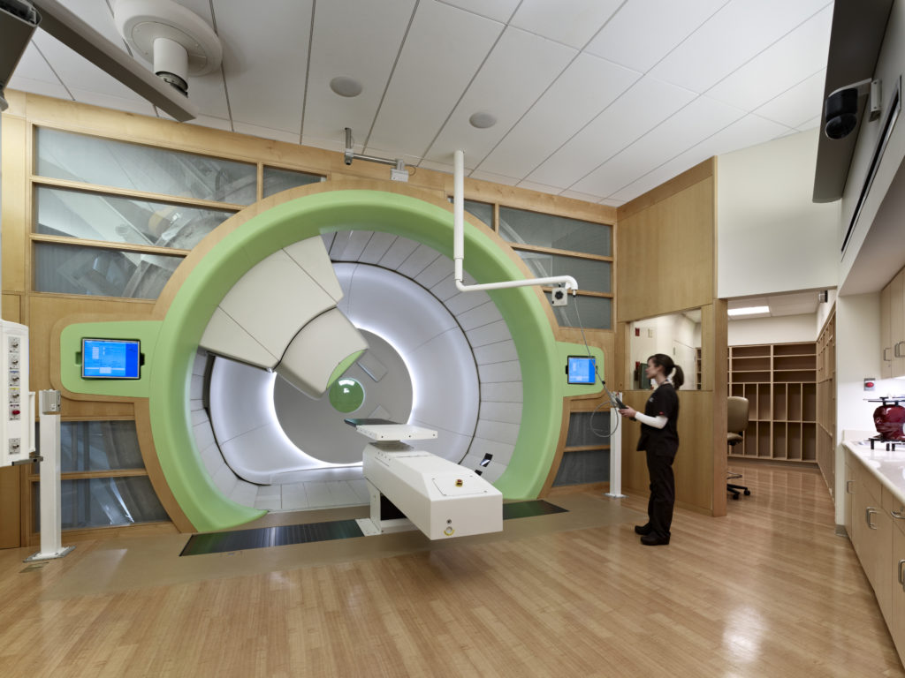
Where Do Requirements Come From?
High-level Requirements come from business strategy, market research and “the voice of the customer”
doug murray
february 9, 2017
doug murray consulting
system architect
Notes:
The customer is usually the main source of requirements, but business and marketing strategy can create “latent” requirements. The Sony Walkman or the Apple iPhone are examples; customers would probably not suggest those things given their choices at the time.

Slide 57
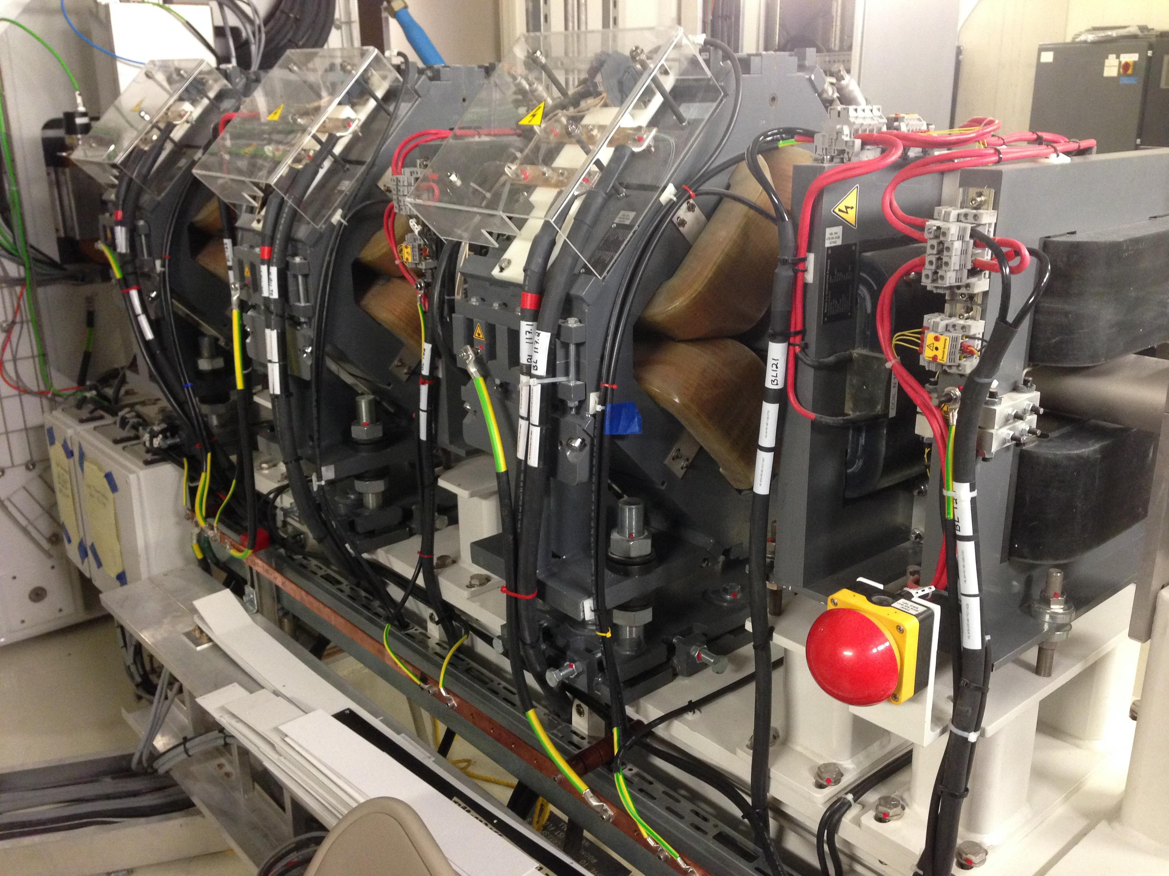
Where Do Requirements Come From?
High-level Requirements come from business strategy, market research and “the voice of the customer”
Lower-level Requirements can be based on customer input only if they understand specific technologies or specifications that are important to their business
doug murray
february 9, 2017
doug murray consulting
system architect
Notes:
Some customers might not understand how their systems will be built, but others do. Clinical customers might specify that protons must reach a certain depth in water, while more technical ones might specify a specific proton energy be supplied. Customers should be dissuaded from specifying technical details like the magnetic field attributes of a quadrupole magnet.

Slide 58
Where Do Requirements Come From?
Lower-level Requirements come from technical experts, based on the Product or Customer high-level requirements
These experts will translate informal requirements into formal ones that are unambiguous and testable, and able to be realized by way of a buildable system
doug murray
february 9, 2017
doug murray consulting
system architect
Notes:
Experienced System Engineers will typically analyze the business, product and customer needs to produce formal, testable requirements.

Slide 59
Where Do Requirements Come From?
To Improve! We want steel-belted radial tires
Management will suggest that once in place, requirements need never change
“…we’ve already built this, why look for new requirements for something we already understand?”
Why re-invent the wheel?
doug murray
february 9, 2017
doug murray consulting
system architect

Slide 60
How Do We Gather Requirements?
first steps, gather the most general ones
Actor
Identify the stakeholders of the product, the roles they play
Use Case
Discover the actions the system must perform for them
Persona
Think of specific individuals in each of those roles
Scenario
Consider how the system operates as those individuals work
doug murray
february 9, 2017
doug murray consulting
system architect

Slide 61
How Do We Gather Requirements?
examples
Actor
Radiotherapist
Use Case
Position patient on treatment table
Persona
Jennifer, 32 year old female Oncologist, working in RT role this day
Scenario
She brings an obese patient in a wheelchair to the couch, lowers it to its lowest point. She decides to request help from Jim, her associate to transfer the patient to the couch.
doug murray
february 9, 2017
doug murray consulting
system architect

Slide 62
How Do We Gather Requirements?
Use Case
performs
Actor
a story describing one aspect of
an individual having the skills or experience of
Scenario
enacts
Persona
doug murray
february 9, 2017
doug murray consulting
system architect

Slide 63
How Do We Gather Requirements?
Actor
The types of users involved with the Use Case
Use Case
Describes activities the product needs to perform
Persona
Specific but fictitious individuals involved with the scenario’s story
Scenario
Detailed account of how that individual makes use of the system, told as a story using natural language
doug murray
february 9, 2017
doug murray consulting
system architect

Slide 64
How Do We Gather Requirements?
Requirements exist to satisfy all stakeholders. Identify the roles played by people that will interact directly with the System, or be affected by it. That could include managers expecting reports from it, or patients expecting treatment from it.
Actor
A good set of Use Cases helps ensure that we’re not missing any requirements. Without Use Cases, the missing requirements are hard to find because they have no source or basis in necessity
Use Case
doug murray
february 9, 2017
doug murray consulting
system architect

Slide 65
How Do We Gather Requirements?
Requirements should be traceable back to the Use Cases and Scenarios that inspired them
Functional Requirements are often gleaned from Actors and Use Cases
Non-Functional Requirements are often gleaned from Personas and Scenarios
doug murray
february 9, 2017
doug murray consulting
system architect

Slide 66
Agenda
Why Requirements?
Writing Requirements
Requirements of Good Requirements
Where Do We Find Them?
Organizing Them
doug murray
february 9, 2017
doug murray consulting
system architect

Slide 67
Agenda
Why Requirements?
Writing Requirements
Requirements of Good Requirements
Where Do We Find Them?
Organizing Them
doug murray
february 9, 2017
doug murray consulting
system architect

Slide 68
How Do We Organize?
Functional Requirements are usually determined first, but requirements gathering is an iterative process
Architecture, Design or Development work can start when only a few functional requirements are understood
Beware - Requirements and the development work that they trigger can change, especially at the project’s start!
doug murray
february 9, 2017
doug murray consulting
system architect

Slide 69
Organizing Requirements
Requirements will ultimately be recorded and stored with their attributes in a repository
Requirements should be organized in a way that helps engineers, testers, quality assurance experts and other stakeholders do their work
doug murray
february 9, 2017
doug murray consulting
system architect

Slide 70
Organizing Requirements
Modern software tools will generate documents (artifacts) based on the repository content
They will also provide version control for each requirement
These tools can also provide stakeholders with custom views of the requirements
doug murray
february 9, 2017
doug murray consulting
system architect

Slide 71
Organizing Requirements
Requirements Repository
Entry
View for Document Control
View for QA
View for Engineering
View for Service
doug murray
february 9, 2017
doug murray consulting
system architect

Slide 72
Organizing Requirements
Some projects need to maintain other requirements-related information which is not specific to any single requirement
•
•
Project Drivers
Project Issues
•
•
Project Constraints
Design Constraints
By keeping additional sections in the repository, more complete and useful documents can be generated
doug murray
february 9, 2017
doug murray consulting
system architect

Slide 73
Organizing Requirements
Functional
These categories ensure the requirements are grouped logically so engineers can easily find them and documents are easily maintained
Non-Functional
Project Constraints
Design Constraints
Project Drivers
Project Issues
doug murray
february 9, 2017
doug murray consulting
system architect

Slide 74
Organizing Requirements
Functional
They also make it easier to develop complete architectures and designs, development plans, good test plans and protocols.
All but the first two are optional.
Non-Functional
Project Constraints
Design Constraints
Project Drivers
Project Issues
doug murray
february 9, 2017
doug murray consulting
system architect

Slide 75
Organizing Requirements
Functional
The fundamental, essential subject matter of the product. They describe what the product has to do or the processing actions it must take
Non-Functional
Project Constraints
Design Constraints
Project Drivers
Project Issues
doug murray
february 9, 2017
doug murray consulting
system architect

Slide 76
Organizing Requirements
Functional
Non-Functional
The properties that the functions must have, such as performance, usability or security. These are often referred to as qualities of the product.
Project Constraints
Design Constraints
Project Drivers
Project Issues
doug murray
february 9, 2017
doug murray consulting
system architect

Slide 77
Organizing Requirements
Functional
Non-Functional
Project Constraints
These remaining categories don’t provide true requirements, but can be used to better communicate those things that affect the requirements
Design Constraints
Project Drivers
Project Issues
doug murray
february 9, 2017
doug murray consulting
system architect

Slide 78
Organizing Requirements
Functional
Non-Functional
These are restrictions on the product such as the budget or time available to build it, market assumptions, naming conventions and more
Project Constraints
Design Constraints
Project Drivers
Project Issues
doug murray
february 9, 2017
doug murray consulting
system architect

Slide 79
Organizing Requirements
Functional
Non-Functional
Project Constraints
Design Constraints
These are technical constraints upon the design, often from legacy issues; use a 4-20 mA signal, using TTL level logic or being backwards compatible with an existing API
Project Drivers
Project Issues
doug murray
february 9, 2017
doug murray consulting
system architect

Slide 80
Organizing Requirements
Functional
Non-Functional
Project Constraints
The business related forces driving the project forward. Trade shows, market changes, supplier schedules
Design Constraints
Project Drivers
Project Issues
doug murray
february 9, 2017
doug murray consulting
system architect

Slide 81
Organizing Requirements
Functional
Non-Functional
Project Constraints
Design Constraints
The business related forces holding the project back, or impacting its success. Project risks, postponed requirements, upgrade paths
Project Drivers
Project Issues
doug murray
february 9, 2017
doug murray consulting
system architect

Slide 82
Organizing Requirements
At the System level or lower, Functional Requirements are kept separate from Non-functional ones
Non-functional requirements will probably change more often than Functional ones during the development process.
Keeping them separate can make documents easier to maintain and tests easier to repeat
doug murray
february 9, 2017
doug murray consulting
system architect
Notes:
For example, performance specifications will be adjusted, physical dimensions might change

Slide 83
How Do We Organize?
Project
requirements are informal and often communicated through a concept document
Product
or customer requirements are a bit more specific, communicated through a requirements document
System
requirements are quite formal and require thorough review, especially in regulated environments
doug murray
february 9, 2017
system architect
february 9, 2017
doug murray consulting

Slide 84
Project Model
Requirements play a crucial role in the “V” process
Product
Requirements
Validation Testing
System
Requirements
Verification Testing
Architecture
Integration Testing
Design
Unit Testing
Development
doug murray
february 9, 2017
doug murray consulting
system architect
Notes:
Everything starts with requirements. But problems seen during integration testing might require architecture changes. Problems seen during verification testing could imply changes to system requirements, then a complete rework through the V-model to continue.

Slide 85
Dependencies
Product
Requirements
Validation Testing
System
Requirements
Verification Testing
Architecture
Integration Testing
Design
Unit Testing
Development
doug murray
february 9, 2017
doug murray consulting
system architect
Notes:
Dependencies simply indicate what’s already happened upon which the current step depends; validation depends upon all verification tests being complete, which in turn depends upon integration being complete
How do I validate the product? First, I depend upon all elements of the system being verified, then I confirm that all product requirements have been achieved.
Similarly, verification of a system depends upon all constituent elements passing their integration tests. If I’m assured of that, I can perform tests that speak to each of the system requirements.

Slide 86
Traceability
Tests and possibly some Design Elements will Reference Requirements
Product
Requirements
Validation Testing
System
Requirements
Verification Testing
Architecture
Integration Testing
Design
Unit Testing
Development
doug murray
february 9, 2017
doug murray consulting
system architect
Notes:
Traceability is more important to the system’s quality than the dependencies. The V & V tests refer back to the requirements, not the quality of their predecessors. We are testing requirements, not the process of verification or integration, for instance. Only some of the design elements, if any, need to refer to requirements but it helps to know if a certain design exists to fulfill specific requirements.

Slide 87
Traceability
Use Cases
Tests and possibly some Design Elements will Reference Requirements
Scenarios
Product
Requirements
Validation Testing
System
Requirements
Verification Testing
Architecture
Integration Testing
Design
Unit Testing
Development
doug murray
february 9, 2017
doug murray consulting
system architect
Notes:
Traceability is more important to the system’s quality than the dependencies. The V & V tests refer back to the requirements, not the quality of their predecessors. We are testing requirements, not the process of verification or integration, for instance. Only some of the design elements, if any, need to refer to requirements but it helps to know if a certain design exists to fulfill specific requirements.

Slide 88
V & V
Verification tells us that we’ve built the system right
Validation tells us the we’ve built the right system
doug murray
february 9, 2017
doug murray consulting
system architect

Slide 89
Organizing Requirements
A Product Requirements Document Describes the Intended Use of the Product
A System Requirements Specification describes what the System will do and how well it will do it
For larger systems, subordinate Requirements Documents describe enough detail to build a testable subsystem
doug murray
february 9, 2017
doug murray consulting
system architect

Slide 90
Organizing Requirements
A Product Requirements Document
Describes what we will Validate
A System Requirements Specification indicates What to Test in the Verification Process
Subordinate Requirements Documents describe What must be Tested to Enable Verification
doug murray
february 9, 2017
doug murray consulting
system architect

Slide 91
Organizing Requirements
At some point in time, requirements are reviewed and a “baseline” established
Requirements will still change or be added
After the baseline has been set, changes will affect the project’s schedule and cost
Each change must be reviewed and the impact considered
doug murray
february 9, 2017
doug murray consulting
system architect

Slide 92
Organizing Requirements
A Complete end-to-end Requirements Specification is a daunting task, especially for complex or large systems
Requirements Specification must be a team effort
None of us is as smart as all of us
doug murray
february 9, 2017
doug murray consulting
system architect

Slide 93
Bibliography
IEEE Standard Glossary of Software Engineering Terminology, IEEE STD 610.12-1990, http://standards.ieee.org/reading/ieee/std_public/description/se/610.12-1990_desc.html
Mastering the Requirements Process—Third Edition by Suzanne Robertson and James Robertson, Addison-Wesley, 2013. ISBN 978-0-321-81574-3
Meeting the Challenges of Requirements Engineering, Bill Thomas, Published in SEI Interactive, March, 1999, http://www.sei.cmu.edu/news-at-sei/features/1999/mar/Spotlight.mar99.pdf
Software Engineering Spring 2005 Lecture 4, New York University, Published on the web Spring 2005, http://www.cs.nyu.edu/courses/spring05/V22.0474-001/lec/lec4_h4.pdf
Writing Quality Requirements, Wiegers, Karl E., http://www.processimpact.com/articles/qualreqs.html
doug murray
february 9, 2017
doug murray consulting
system architect

Slide 94
Bibliography
Writing Good Requirements, Hooks, Ivy, http://www.complianceautomation.com/papers/writingreqs.htm, INCOSE 1993
Writing Good Requirements, Karl Wiegers, Published in Software Development Magazine, May 1999, http://www.cs.bgu.ac.il/~elhadad/se/requirements-wiegers-sd-may99.html.
Writing Good Requirements (A Requirements Working Group Information Report), Ivy Hooks, Published in Proceedings of the Third International Symposium of the INCOSE, Volume 3, 1993, http://www.itmweb.com/essay543.htm.
Writing good requirements is a lot like writing good code, Jim Heumann, IBM, 30 June 2004, http://www-106.ibm.com/developerworks/rational/library/5170.html.
doug murray
february 9, 2017
doug murray consulting
system architect

Slide 95
Managing Requirements
doug murray consulting
Thank you for your attention
doug murray
february 9, 2017
system architect

